Slide 1

SupplyWise
Notes:
4

Slide 2




Problem: Sourcing is Trapped Between Risk and Inefficiency.
Same Materials. Better Supplier.
No Way to Know.
Blind Sourcing
Weeks to Evaluate One Alternative
Risky Cost
of Opportunity
Hundreds of raw materials, no way to spot a better supplier or a compliance risk.
Manual catalog search, cert checks, reg cross-referencing. Most teams just skip it.
Wrong switch means recalls. Default is inaction — and inaction is expensive.
Organizations deploying analytics in procurement report up to 20% savings potential, yet only ⅓ use e-sourcing tools today. — McKinsey, 2025
Notes:
1

Slide 3



Our solution: material options, curated for You.
Better Raw Materials for Your Brand —
With the Proof to Switch.
Ranked suppliers with confidence scores.
By Agnes.
See What’s Possible
Cost
Regulatory Compliance
Certification Fit
Supply Risk
Functional Fit.
Tune to Your Priorities
Ask, Don’t Search
Reasoned solutions with a simple voice command
For any material in your BOM, instantly see the best suppliers, compliance status, and substitution options.
Notes:
2

Slide 4
supplywiseai.vercel.app

Slide 5
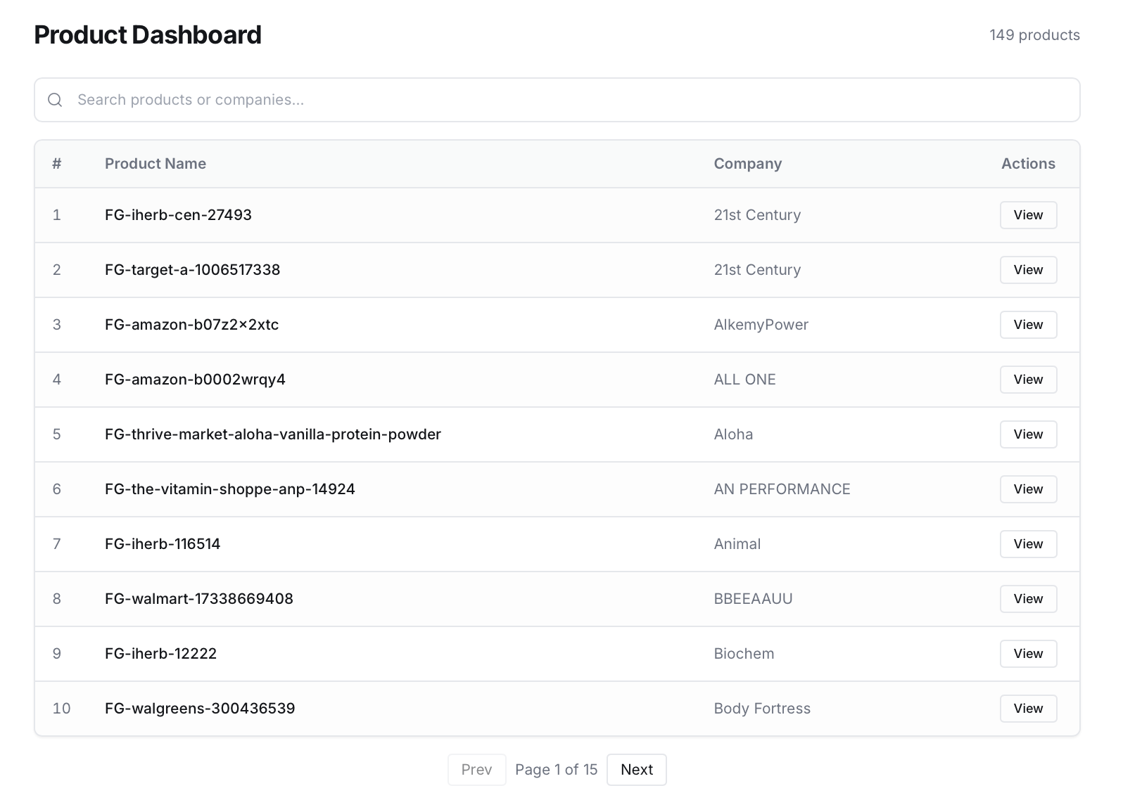

Slide 6
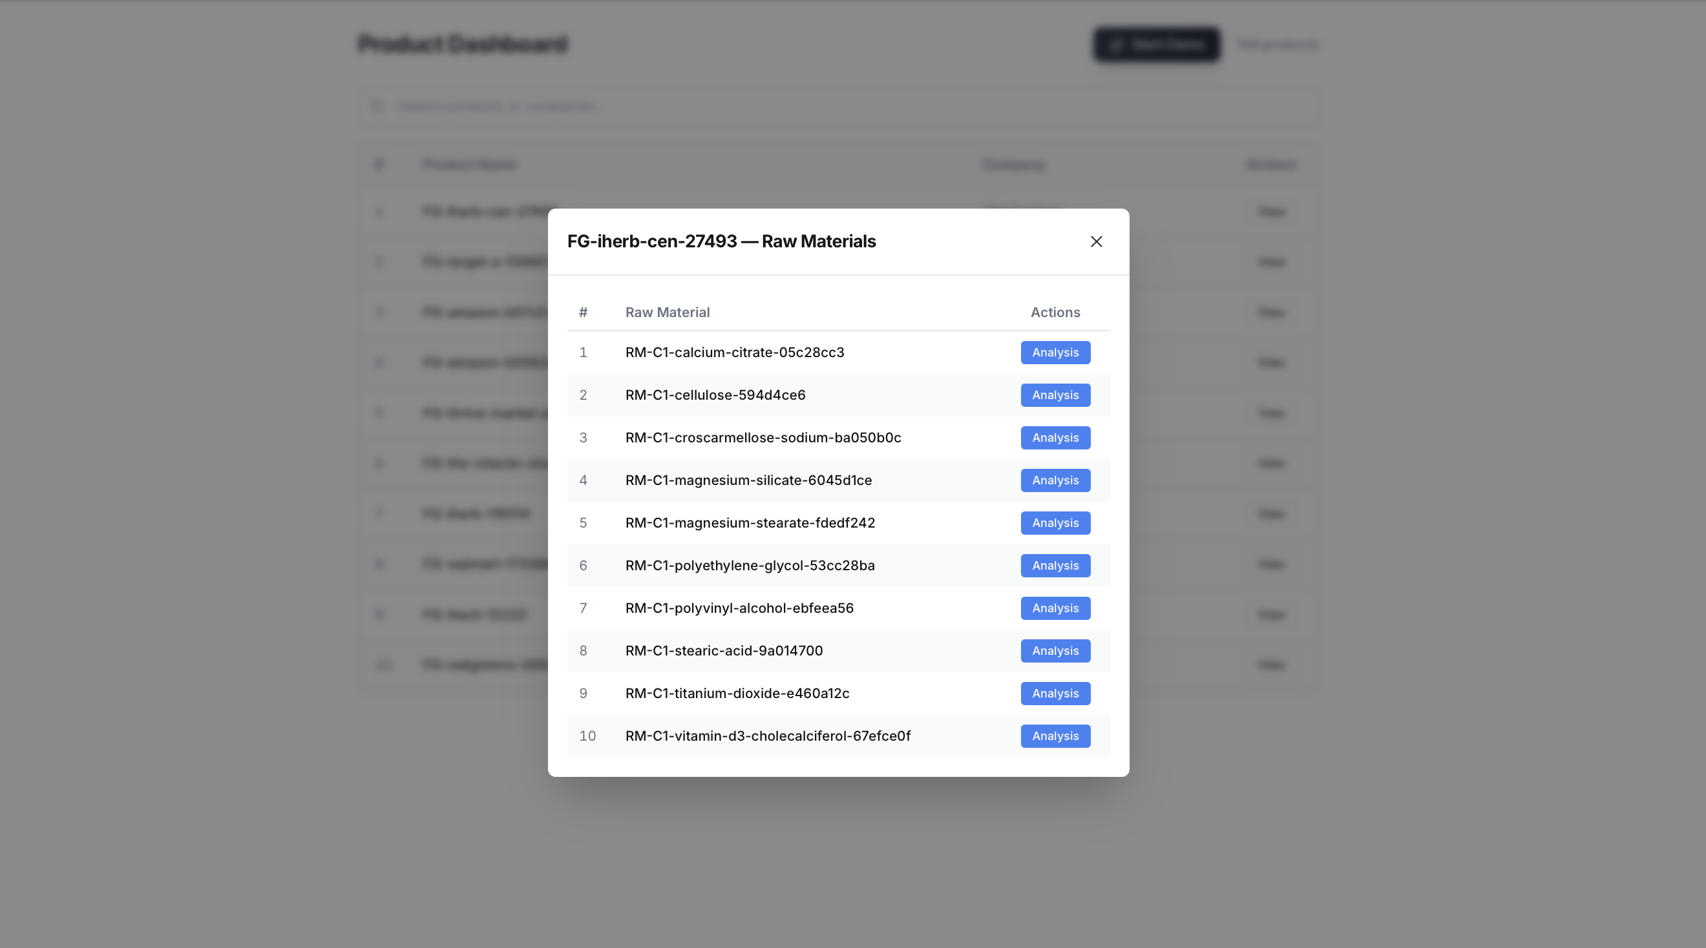

Slide 7
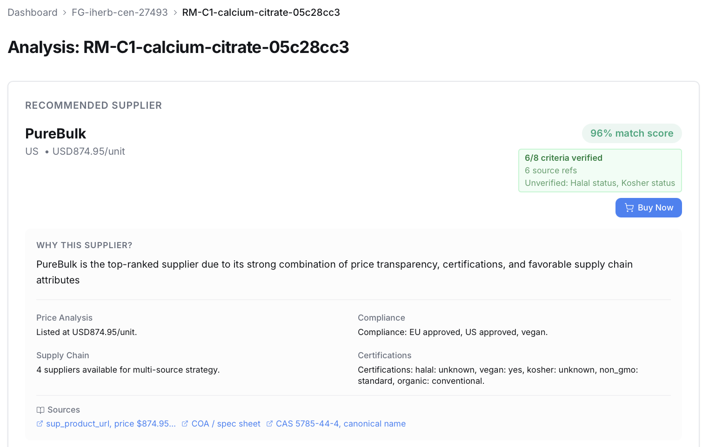

Slide 8
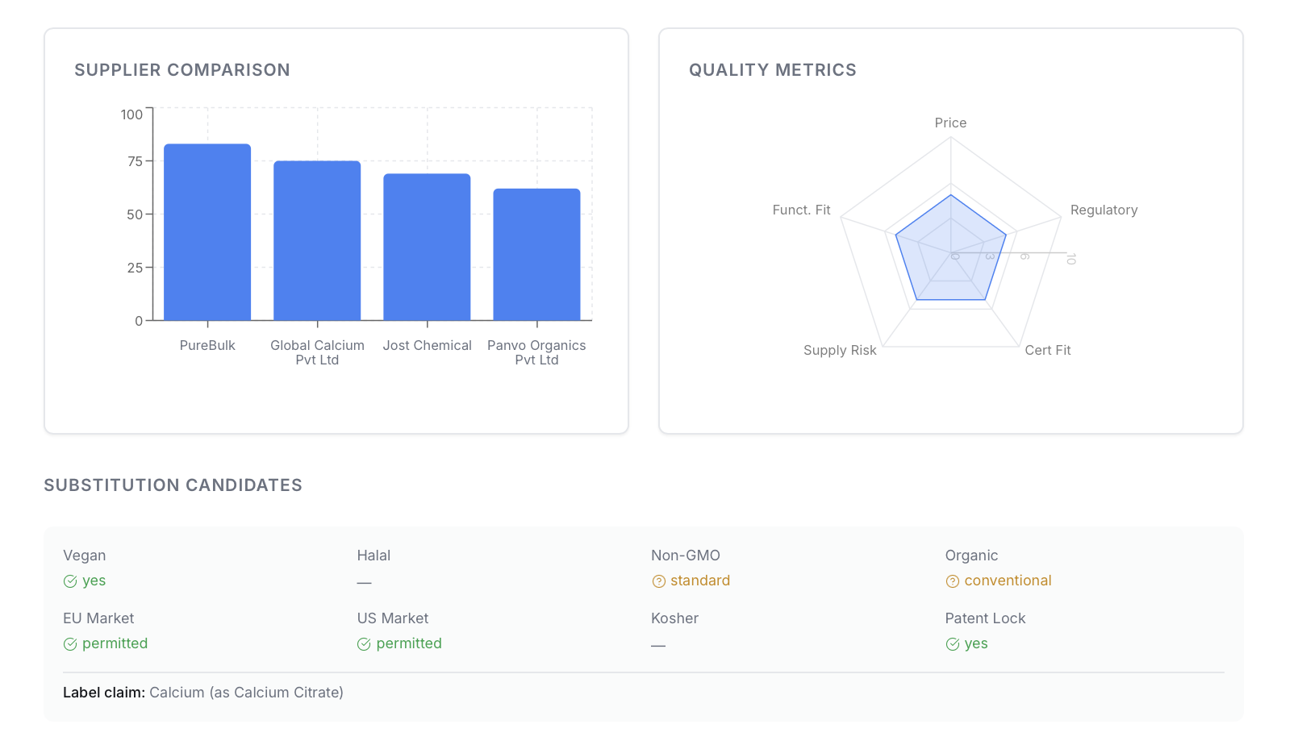

Slide 9
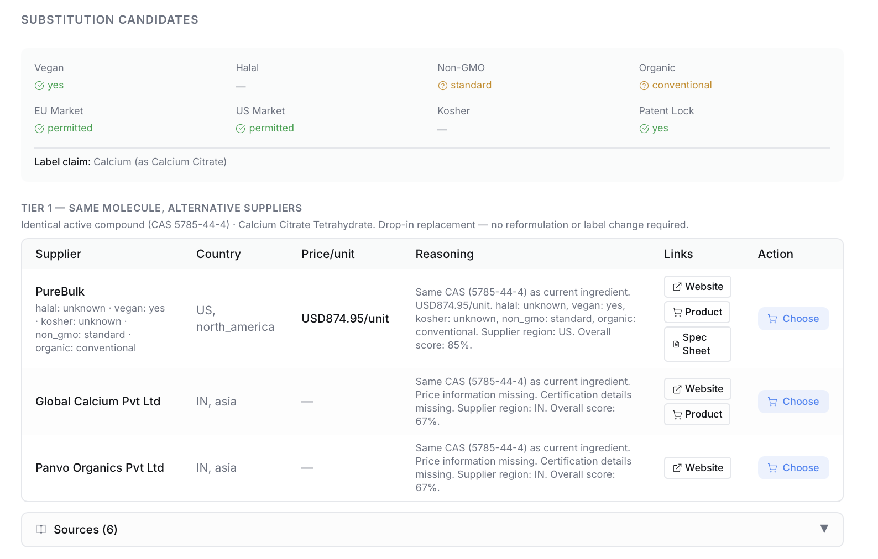

Slide 10
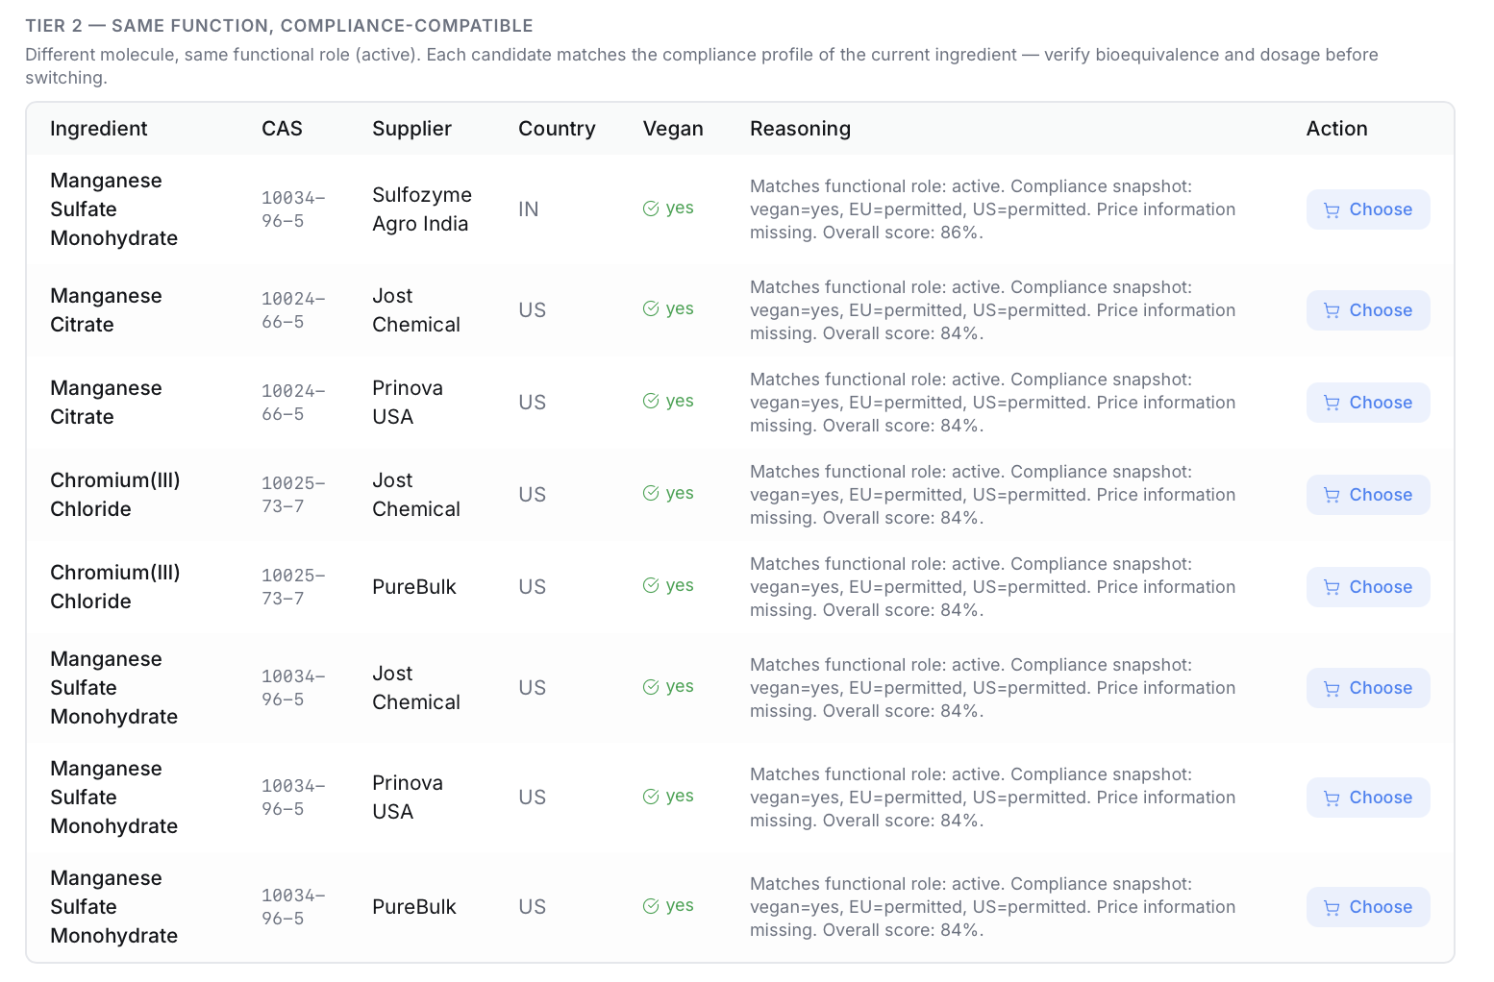

Slide 11
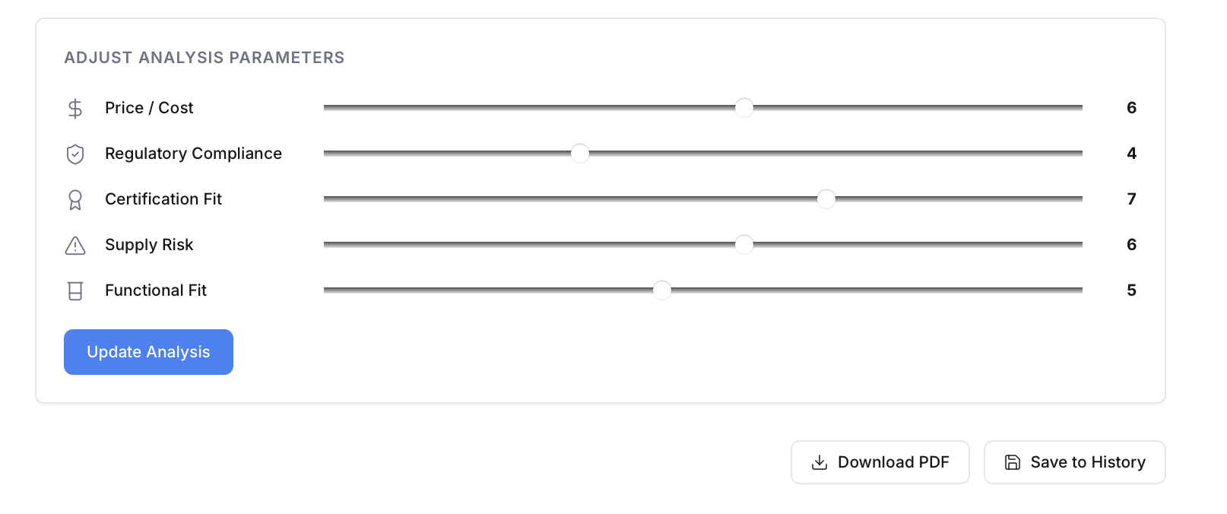

Slide 12
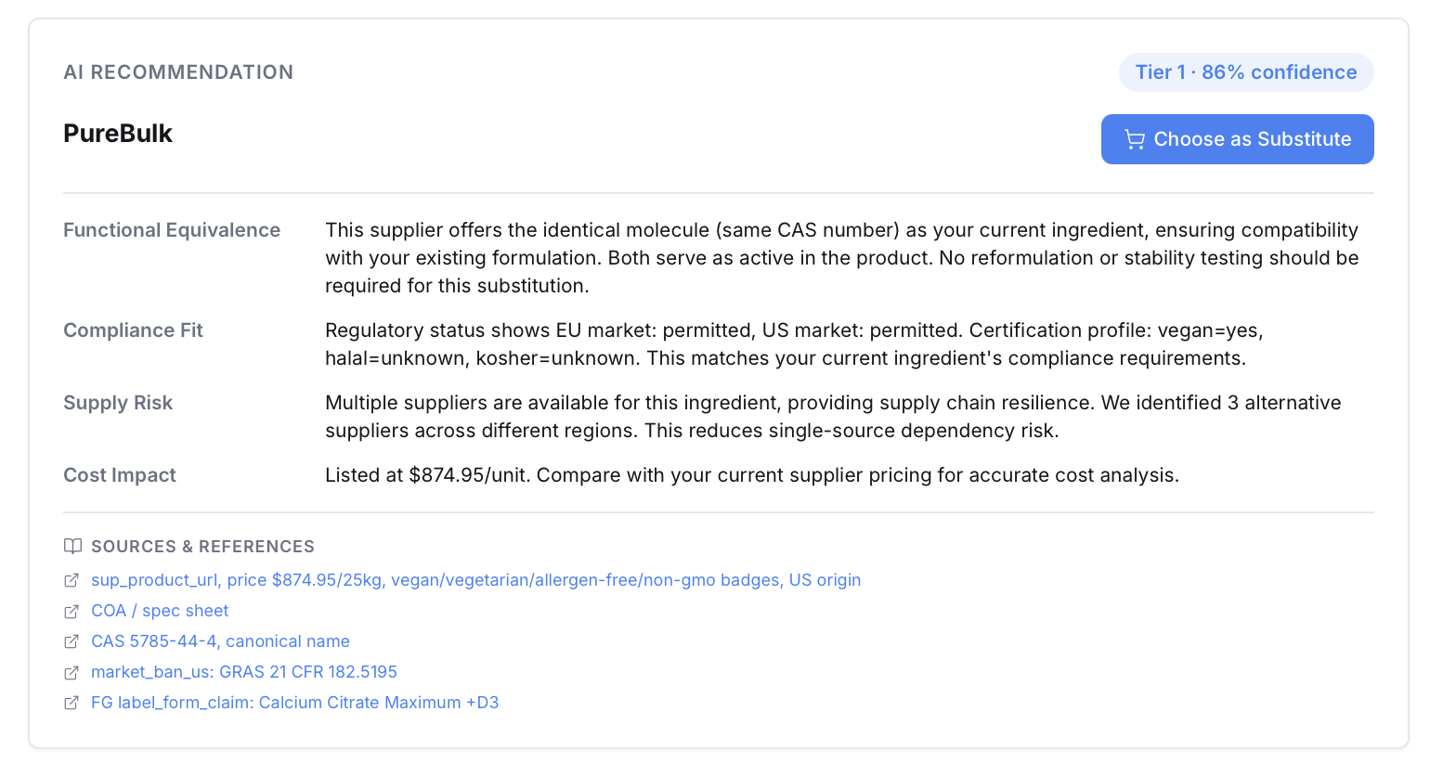

Slide 13
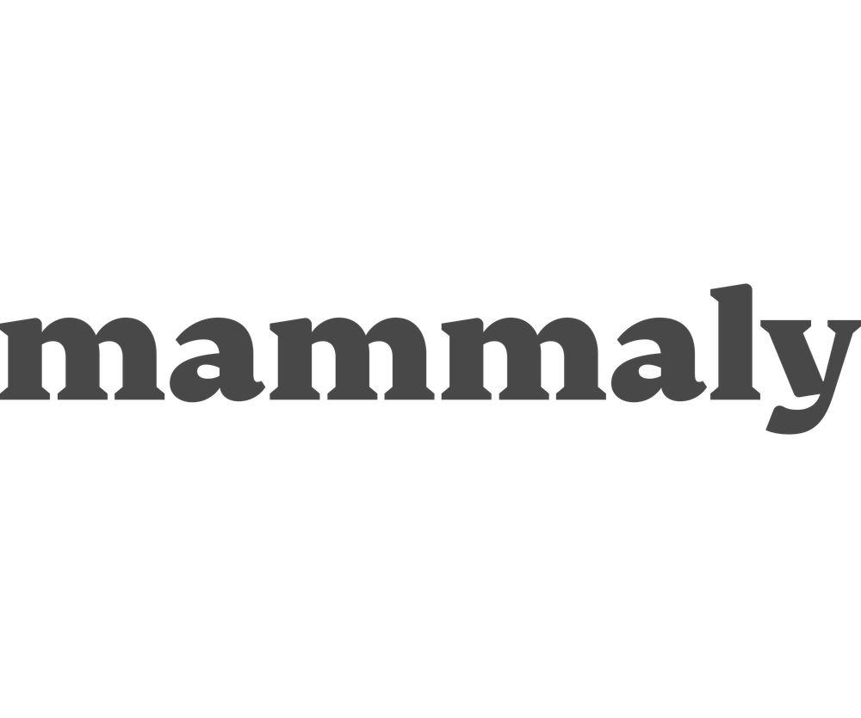




Business Model: You Only Pay When It Pays Off.
We Make Money When You Save Money.
Free Tier
Why This Is Real
Start in minutes, not months.
Browse suppliers, explore BOMs, run basic analyses. No commitment required.
Paid Deep Analysis
Agnes runs forecasting & inventory. We add the missing layer: raw material intelligence.
Go deep when it matters.
Full compliance profiles, 3-tier substitution, and evidence trails — per search or subscription.
Our data compounds with every decision. That moat can't be copied overnight.
Supplier Commission
Commission-only model. Pure alignment, we earn when you save.
We only win when you do.
When you buy from a recommended supplier, we earn a referral. No savings, no fee.
Agnes already manages forecasting and inventory. SupplyWise gives her the one thing she was missing — raw material superpowers.
Notes:
5

Slide 14
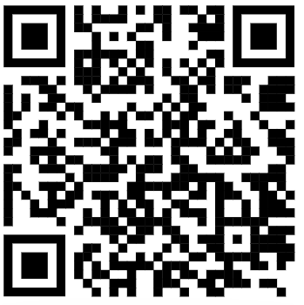
Watch Agnes think.
supplywiseai.vercel.app
Notes:
3

